Slide 1
Sales Performance & Business Intelligence Analysis
Data Analytics Internship Project
Prepared by: [Seeram.Meghana]
Tools Used:
SQL Server
Excel
Power BI
GitHub

Slide 2
PROJECT OBJECTIVE:
The main objective of this project is to analyze sales data, identify business trends, and generate actionable insights using data analytics and business intelligence tools.
The project focuses on:
Data cleaning and preparation
Exploratory Data Analysis (EDA)
KPI tracking
Interactive dashboard creation
Customer segmentation analysis
Business decision support

Slide 3
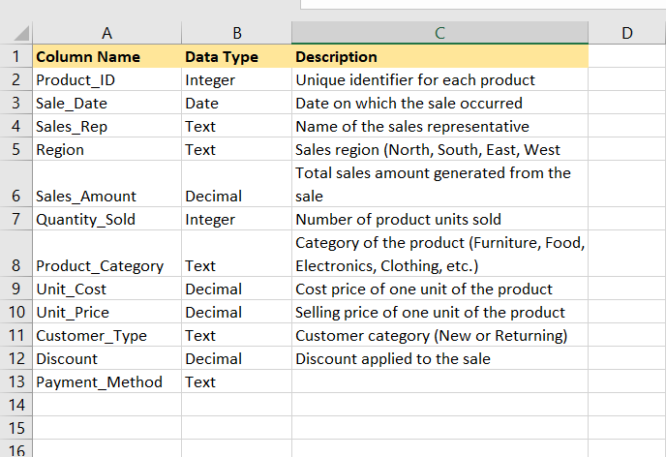
Dataset Overview:
The dataset contains sales transaction information including:
Product details
Sales amount
Quantity sold
Customer type
Payment methods
Sales regions
Sales channels
Dataset Information
Total Records: 1000
Tools Used: SQL Server, Excel, Power BI
Dataset Type: Sales Dataset

Slide 4
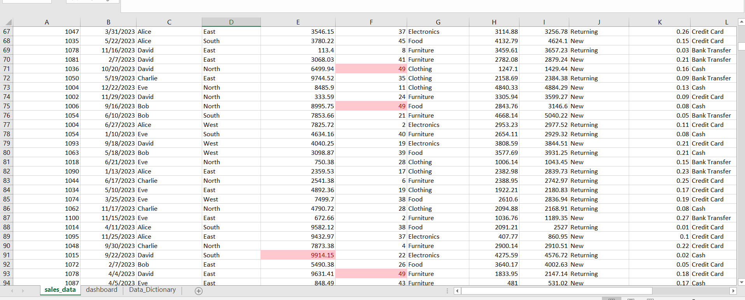
Data Cleaning Steps:
Removed missing values
Standardized column names
Verified data types
Created calculated fields
Imported cleaned dataset into SQL Server and Power B

Slide 5
Core Key Performance Indicators (KPIs):
KPI | Formula | Business Purpose
Total Sales | SUM(Sales_Amount) | Measures total business revenue
Total Orders | COUNT(Product_ID) | Tracks total transactions
Average Sales | AVG(Sales_Amount) | Measures average order value
Total Quantity Sold | SUM(Quantity_Sold) | Tracks product sales volume
KPI Importance
These KPIs help monitor sales performance, customer purchasing behavior, and overall business growth.

Slide 6
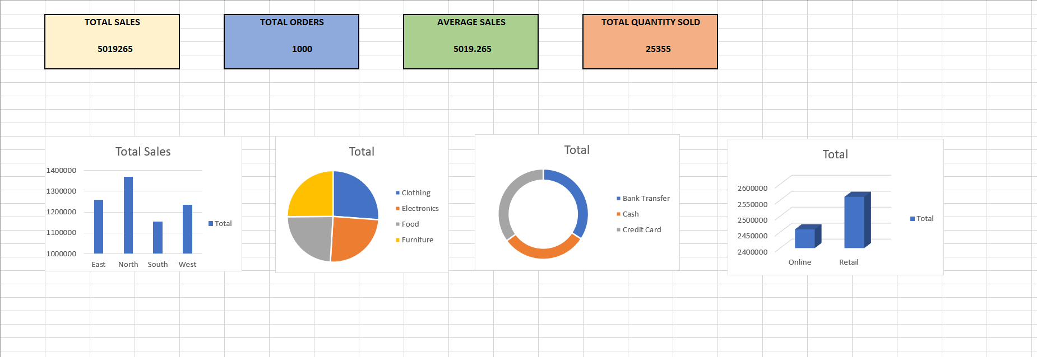
Exploratory Data Analysis:
Exploratory Data Analysis (EDA)
EDA was performed to identify patterns, trends, and relationships within the sales dataset.
Analysis Performed
Regional sales analysis
Product category analysis
Customer type analysis
Sales channel analysis
Payment method analysis
Key Findings
North region generated the highest sales revenue.
Clothing category contributed maximum revenue.
Sales performance varied across customer segments.

Slide 7
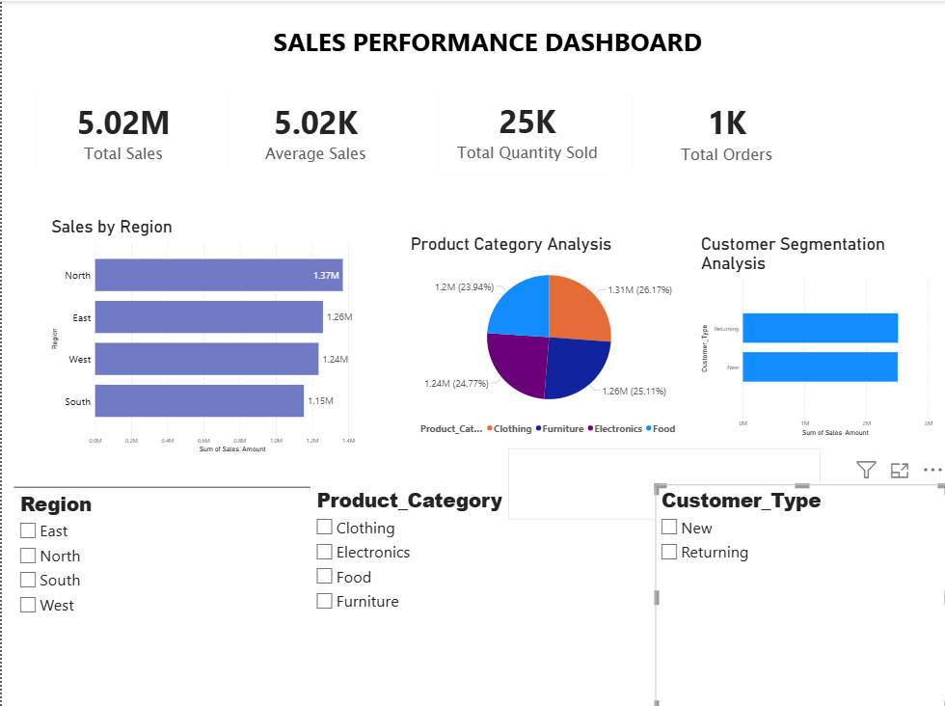
Interactive Dashboard:
Interactive Power BI Dashboard
An interactive dashboard was developed using Power BI to visualize sales performance and business trends.
Dashboard Features
KPI cards
Sales by region chart
Product category analysis
Interactive slicers/filters
Customer segmentation visuals
Benefits
Easy business monitoring
Real-time filtering
Better decision-making
Improved data visualization
(Add Dashboard Screenshot Here)

Slide 8
Deep-Dive Analysis:
Customer Segmentation Analysis
Customer segmentation analysis was performed to understand customer behavior and sales contribution.
Segmentation Factors
Customer type
Product preferences
Sales contribution
Purchasing patterns
Insights
Certain customer groups generated higher sales revenue.
High-value customers contributed significantly to overall business growth.
Customer segmentation can improve targeted marketing strategies.

Slide 9
Hypothesis Testing:
Business Hypothesis Testing
Hypothesis
"There is a significant difference in sales between customer types."
Statistical Test Used
T-Test
Hypotheses
Null Hypothesis (H₀): There is no significant difference in sales between customer types.
Alternative Hypothesis (H₁): There is a significant difference in sales between customer types.
Result
p-value < 0.05
Conclusion
The analysis indicates that customer type has a significant impact on sales performance.

Slide 10
Business Recommendations:
Recommendations
Focus marketing strategies on high-performing regions.
Improve performance of low-performing product categories.
Use customer segmentation for targeted promotions.
Monitor KPIs regularly for business growth.
Enhance customer engagement through personalized offers.

Slide 11
Conclusion:
This project successfully demonstrated how data analytics and business intelligence tools can be used to analyze business performance and support decision-making.
Through SQL, Excel, and Power BI:
Sales trends were identified
KPIs were tracked
Interactive dashboards were developed
Business insights were generated
The project enhanced understanding of:
Data cleaning
EDA
Dashboard development
Business intelligence
Data-driven decision making

Slide 12
Thank You

